Slide 1
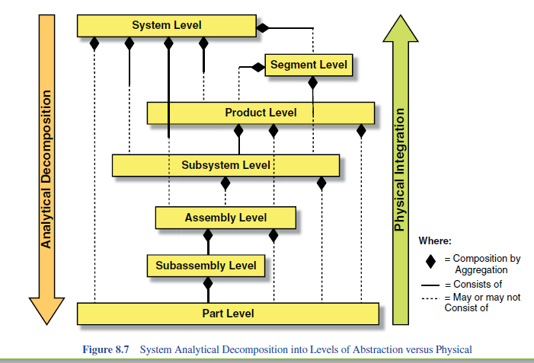
Levels of abstraction

Slide 2
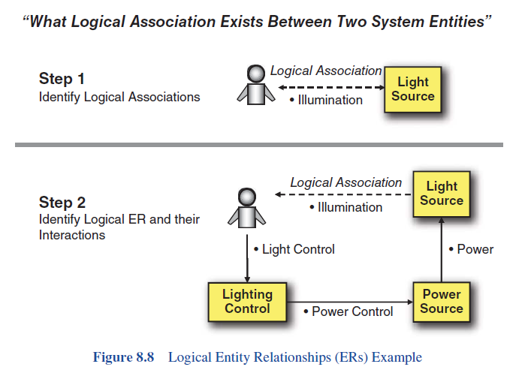
Entity relations

Slide 3
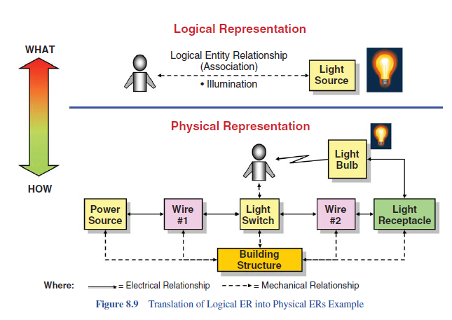
Logical to Physical ER

Slide 4
Challenge for System Responses
how do you measure an external system response such as a human that has no intention of producing a response?
The reality is: Human Systems may or may not produce an output to avoid detection, survival, or it might be internal-thought driven and so forth.

Slide 5
Simplified architecture/definition with a example- a digital game
Entity Component System) consists of three primary items:
Components
A component simply holds a piece of data and does not contain any game logic. Your typical component will have fields for primitive values and data objects.
Entities
An entity is a collection of components.
Systems
A system is typically an implementation that iteratively operates on a group of entities that share a specific set of components.

Slide 6
A game with characters moving around….. https://www.youtube.com/watch?v=3BVXynuhNfI
Define the components:
Motion component
Physics component
Spatial component
EnemyAI component
Entities: human Player-entity (movement, reasoning) & non-player characters.
Systems:
RenderSystem – acts on physics & spatial components
MotionSystem – acts on Motion & Physics components
PlayerInputSystem –acts on Motion & Spatial components
I am assuming the EnemyAI is common to all these entities.

Slide 7
marketing
Planning
Design
Concept Dev
System-Level
Design
HR
Detail Design
Manufacturing
Testing
& Refinement
R&D
Production
Ramp-up
Finance

Slide 8
Spiral Product Development Process
Design
build
Test
Planning
Concept Dev
System-Level
Design
Detail Design
Testing
& Refinement
Production
Ramp-up

Slide 9
Complex Systems Devp Process
Design
Test
Planning
Design
Test
Concept Dev
Design
Test
System-Level
Design
Detail Design
Integrate & Test
Validation &
Ramp-up

Slide 10
Generic PD process
Process Type | Desc | Examples
Generic (Market-Pull)Products | The Team begin with a market opportunity & selects appropriate tech | sporting goods, furniture,tools
Technology-push | The team begins with a new tech, then finds a market | High-end shoes
Platform | The team assumes that the new product will be built around an established tech subsytem | computers,printers,ipads
Process-intensive | Characteristics of the product are highly constrained by the production process | snack foods, chemicals
customized products | new products are slight variations of exisiting configurations | motors,switches,containers
high-risk | technical & market uncertainities create high risks of failure | pharma, space systems
quick build | rapid modelling & prototying enables many design-build-test cycles | software, cellular phones
complex systems | systems must be decomposed into sevral subsystems and many components | airplanes, automobiles

Slide 11
Product Architecture

Slide 12
Modular Architecture
chunks implement one or a few elements
interactions between chunks are well-defined and fundamental to the primary functions of the product
allows a design change in one chunk without requiring changes to other chunks
most modular: each functional element is implemented by exactly one chunk

Slide 13
Integral Architecture
functional elements of the product are implemented using more than one chunk
a single chunk implements many elements
interactions between chunks ill-defined, may be incidental to the primary functions of the products
used with products with highest possible performance in mind

Slide 14
Types of Modularity
Slot-modular architecture
Bus-modular architecture
Sectional-modular architecture

Slide 15
Slot-Modular Architecture
each interface between chunks different - various chunks cannot be interchanged
example: automobile radio - implements exactly one function, but interface different from any other components in the vehicle

Slide 16
Bus-Modular Architecture
a common bus to which chunks connect via the same type of interface
examples: track-lighting, shelving system with rails, expansion card for PC

Slide 17
Sectional-Modular Architecture
all interfaces of same type, but no single element to which all other chunks attach
assembly built by connecting chunks to each other via identical interfaces
examples: piping systems, office partitions

Slide 18
Fundamental Decisions
Integral vs. modular architecture?
What type of modularity?
How to assign functions to chunks?
How to assign chunks to teams?
Which chunks to outsource?

Slide 19
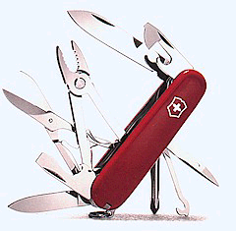
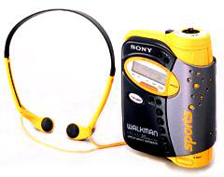
Modular Product Architectures
Chunks implement one or a few functions entirely.
Interactions between chunks are well defined.
Modular architecture has advantages in simplicity and reusability for a product family or platform.
Swiss Army Knife
Sony Walkman

Slide 20
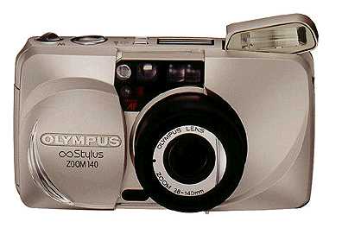
Integral Product Architectures
Functional elements are implemented by multiple chunks, or a chunk may implement many functions.
Interactions between chunks are poorly defined.
Integral architecture generally increases performance and reduces costs for any specific product model.
Compact Camera

Slide 21
Integral vs. Modular
Integral
Higher system performance
Tightly coupled design teams
Hard to change
Modular
Reduced performance
Decoupled design teams
Requires clear definition of interfaces
Increased flexibility
Accommodates made-to-order products
Notes:
A single straight screwdriver is often more satisfying than an interchangeable tip screwdriver wit the same blade
21

Slide 22
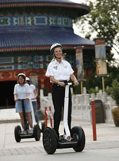
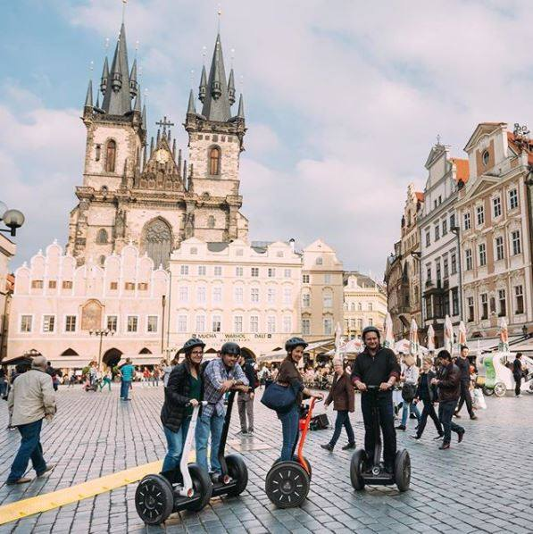
Case Study – NPD Segway

Slide 23
Segway
http://www.youtube.com/watch?v=EBC0h7jxxM8

Slide 24
marketing
Planning
Design
Concept Dev
System-Level
Design
HR
Detail Design
Manufacturing
Testing
& Refinement
R&D
Production
Ramp-up
Finance

Slide 25
New Product Development(NPD)
Many R&D projects never result in a commercial product, and between 33 and 60% of all new products that reach the market place fail to generate an economic return (Blagoevski-Trazof, 2007: 195).
A company’s new product must meet the following two basic objectives: 1) minimize time-to-market and 2) maximize the fit between customer requirements and product characteristics

Slide 26
About the company
Segway Inc., a US-based international company, is named after its flagship product, the Segway Personal Transporter (PT), the first self-balancing transportation device in the world.
The company was founded by Dean Kamen in 1999
Segway went on sale for the first time to the public on Amazon.com in 2002
As of 2008, over 1,000 police and security agencies are using Segway PT’s in their patrolling operations worldwide.
2012: Segway boasts a worldwide network of more than 250 distributors, dealers and experience centers in 80 countries across the globe.
In September 2014, Segway filed a complaint about the infringement of several of its patents by several Chinese companies, including Ninebot, Shenzhen INMOTION Technologies and Robstep Robot.
Acquired by Ninebot (Chinese company) in 2015

Slide 27
Segway technology
The Segway PT senses the lean of the rider with the assistance of five micro-machined angular rate sensors and two accelerometers that sense the angle of the PT, with respect to gravity, at 100 times per second.
It balances the rider by applying forces to the ground in the direction of the lean. If you lean forward the PT applies motor torque to the wheel to push it forward, bring you upright and balance you. When you lean back, it applies reverse torque to slow you down and balance you accordingly

Slide 28
Phases
Phase 1: Opportunity identification and selection
Phase 2: Concept generation
Phase 3: Concept evaluation
Phase 4: Development
Phase 5: Launch

Slide 29
Phase 1: Opportunity identification and selection
Dean Kamen’s mission: a new DISCOVERY to replace the car, solve the problem of congestion, air pollution and dependency on fuel**.
Design idea : focus on creating devices that took up a minimal amount of space, were extremely maneuverable and could operate on pedestrian sidewalks and pathways
Market opportunity : universities, police force, security companies, and large retailers
** In 1999, the United States consumed 95 quadrillion BTUs of energy, while producing 61 quadrillion BTUs. The result being a 34 quadrillion BTU energy deficit.

Slide 30
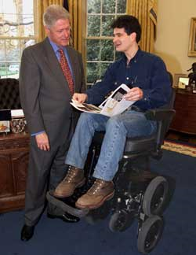
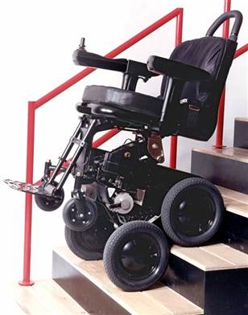
Phase 1: Opportunity identification and selection
Inspired by :iBOT wheelchair

Slide 31
Concept generation
Consumer feedback: The first problem was of Segway not being taken seriously by consumers who regard this invention as simply a high-end toy.
Team decides to concentrate at first on major corporations, universities and government agencies--large, solid, established institutions--rather than dive straight into the consumer marketplace
Design specifications: small footprint, flexibility, lightweight, run on electricity
Design specs on Safety : Segway equipped with three computerized keys that set speed and performance limits to ensure safety on pedestrian pavements

Slide 32
Concept Evaluation
Category | Factor | Scale | Score | Weight (1-5) | Weighted score
Technical accomplishment | Technical task difficulty | 1: difficult | 4 | 4 | 16
 |  | 5: easy
 | Research skills required | 1: none | 5 | 3 | 15
 |  | 5: perfect fit
 | Development skills required | 1: none | 4 | 2 | 8
 |  | 5: perfect fit
 | Technical equipment/processes | 1: none | 5 | 3 | 15
 |  | 5: have them
 | Rate of technological change | 1: high | 5 | 2 | 10
 |  | 5: stable
 | Designing superiority assurance | 1: none | 5 | 2 | 10
 |  | 5: high
 | Security of design | 1: none | 5 | 2 | 10
 |  | 5: have patent
 | Technical services required | 1: none | 2 | 3 | 6
 |  | 5: have it all
 | Manufacturing equipment/processes | 1: none | 3 | 5 | 15
 |  | 5: have them
 | Vendor cooperation | 1: none | 2 | 3 | 6
 |  | 5: have them
 | Likelihood of competitive cost | 1: above competition | 1 | 2 | 2
 |  | 5: 20% less
 | Likelihood of quality product | 1: below current levels | 5 | 5 | 25
 |  | 5: leadership
 | Likelihood speed of to market | 1: 2 years or more | 1 | 5 | 5
 |  | 5: under 6 months
 | Team people available | 1: none | 3 | 3 | 9
 |  | 5: have them
 | Dollar investments required | 1: over 20 million | 1 | 2 | 2
 |  | 5: under 1 million
 | Legal issues | 1: major | 2 | 3 | 6
 |  | 5: minor
 | Total |  |  |  | 160

Slide 33
Commercial accomplishment | Market volatility | 1: high | 2 | 4 | 8
 |  | 5: stable
 | Probable market share | 1: low | 5 | 4 | 20
 |  | 5: high
 | Probable product life | 1: short | 4 | 2 | 8
 |  | 5: long
 | Sales force requirements | 1: no experience | 1 | 4 | 4
 |  | 5: very familiar
 | Promotion requirements | 1: no experience | 2 | 4 | 8
 |  | 5: very familiar
 | Target customer | 1: strangers | 2 | 3 | 6
 |  | 5: close
 | Distributors | 1: no relationship | 4 | 4 | 16
 |  | 5: current/strong
 | Retailers | 1: no relationship | 2 | 4 | 8
 |  | 5: current/strong
 | Importance of task to user | 1: trivial | 5 | 3 | 15
 |  | 5: critical
 | Degree of unmet need | 1: none | 5 | 4 | 20
 |  | 5: totally
 | Likelihood of filling need | 1: low | 5 | 3 | 15
 |  | 5: high
 | Competition to be faced | 1: tough | 4 | 3 | 12
 |  | 5: weak
 | Environmental effects | 1: negative | 5 | 3 | 15
 |  | 5: positive
 | Global applications | 1: none | 5 | 3 | 15
 |  | 5: fits global
 | Probable profit | 1: low | 2 | 4 | 8
 |  | 5: high
 | Total |  |  |  | 178

Slide 34
Sales prediction for NPV
“Dean Kamen, before selling a single Segway, he predicted that his company would sell 10,000 units per week, or 50,000 units a year “

Slide 35
Development
Segway’s claim to fame – is that it develops systems not components or integrates parts….
so the main systems developed are:
Dynamic stabilization - enables balancing, incredible maneuverability (true zero turning radius)
Electric propulsion - fine adjustments to be made to each wheel (for turning and smoothing out the ride), and a precise, software-based approach to traction control and braking.
Smart battery management - includes regenerative braking capability (being able to recharge while decelerating).
Intuitive user interfaces - sensing technologies
Digital dashboard - Speed, battery life, and other connectivity information are all conveyed over a secure wireless connection to a handheld device that can be mounted on the dash

Slide 36
Launch
Sales through - Amazon.com – shipping costs
Analysis
Pre launch ‘leaks’ were huge.
Code named – Ginger or IT.
Speculations - hydrogen-powered hovercraft; a magnetic anti-gravity device; a time-travel machine; a mind-reading robot
Thus: when Segway was revealed to the US, it was an anti-climax. Coupled with the high price, Segway never got a chance with consumers afterwards.

Slide 37
analysis:
Phase 1: Opportunity identification and selection – achieved his mission
Phase 2: Concept generation – short on price point estimation , safety is an issue due to many software glitches.
Phase 3: Concept evaluation - sales forecast was too high – hence poorly executed phase.
Phase 4: Development -technologies serve the objectives of the vehicle well and in an advanced manner. Thus this phase has been a success
Phase 5: Launch : did not manage its launch, media & public relations was poor, hype was not quelled

Slide 38
Why Segway is still a curiosity and not a commodity?
Expectations were too high.
It was a product not a solution.
No clear need or target market.
It was an invention rather than an innovation.
Regulation.

Slide 39
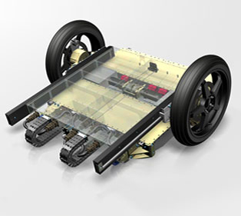
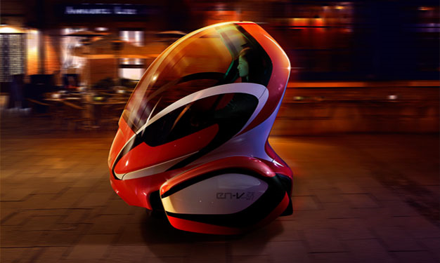
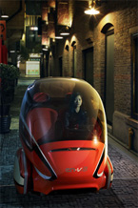
Next from Segway….
A collaboration between Segway and General Motors/SAIC, the EN-V project sets a vision for transportation in 2030
Speed : 40 km/h [25 mph]
Range : 40 km [25 miles]
Drivetrain weight 210 kg [460 lb] - common across all three coach designs
Average cabin dimensions: 1520 x 1415 x 1682 [60" x 55.5" 66.1"]

